Slide 1


City of Rochester, NH
FY 2027 Water and Sewer Rate Study
City Council Meeting
October 20, 2026

Slide 2
Raftelis has provided financial/ organizational assistance for
1,700+
public agencies and utilities
that serve more than
25%
of the U.S. population
including the agencies serving
41
of the nation’s 50 largest cities
Who is
Raftelis?
The most experienced
utility financial and management consulting practice in the nation.

Slide 3
Regional
Experience
We have personally worked with 100+ utilities across New England and the Northeast, ranging from small village districts to large cities such as Boston

Slide 4
Utility Rate Study Basics
Rochester engaged Raftelis to address concerns around rate sufficiency given foreseeable capital investments
Goals are to: (1) ensure the long-term financial sustainability of the water and sewer utilities, and (2) assess the impacts of changes to Rochester’s utility customers
1
2
3
4
Background & Framework
  Financial goals and policies
  Drivers
Financial Plan ($)
  Identify annual cash needs
  Evaluation of CIP impacts
  Cash flow analysis for durable financial sufficiency
Rate Design
  Historical consumption analysis
  Rate options modeling
  Customer impact analyses
Rate Adoption
  Recommendations
  Report
  Presentation
Step 1 – Identifying the revenue needed to ensure Enterprise Fund sustainability
Step 2 – Updating charges and rates to equitably generate needed revenues from the customer base
4

Slide 5
Industry Trends
Rochester, like many utilities, are facing the need to make necessary capital investments while minimizing the impacts to their customer base
Broader industry trends:
  Water rates across the country are increasing by 5% per year, on average, according to the American Water Works Association
  Sewer rates across the country are increasing by 6% per year, on average, according to the American Water Works Association
  Inflationary impacts, aging infrastructure and declining consumption are the biggest challenges impacting utilities throughout the country

Slide 6
How Did We Get Here?
Water and Sewer Funds are enterprise funds and are expected to be financially self-sufficient through user rates and charges
Rate increases have been deferred or minimized over successive budget cycles, even as operating and capital costs continued to rise
The resulting revenue shortfalls have required General Fund support to cover operating deficits, a practice that is not sustainable over the long term and inconsistent with enterprise fund principles
The City has had to issue a $7.3 million loan to address accumulated operational deficits
The growing gap between costs and revenue has compounded over time, making the necessary adjustment larger than it would have been with regular, incremental increases
The recommended rate adjustments are designed to eliminate General Fund dependence and establish each utility as a self-sustaining operation

Slide 7
Operating Reserve Fund Key Points
Reserves help the utilities maintain financial self-sufficiency and sustainability
Reserves can help prevent the need for rate increases in response to emergency expenses or revenue shortfalls, providing customers with rate stability
Industry best practices recommend water and sewer reserve funds maintain a higher relative cash balance than municipal general funds due to the volatility of water and sewer revenues

Slide 8
Revenue Requirement Assumptions

Slide 9
Revenue Requirement Assumptions for Rate Study
Financial model uses the FY 2027 budgets as the basis for O&M and capital projections during the forecast period (FY 2027 – FY 2032)
Water budgeted revenue requirements are projected to increase by 15% in FY 2027 compared to FY 2026 actual expenditures
Sewer budgeted revenue requirements are projected to increase by 32% in FY 2027 compared to FY 2026 actual expenditures
Water Fund plans to spend approximately $53 Million on capital improvements over FY 2027 – FY 2032
Sewer Fund plans to spend approximately $127 Million on capital improvements over FY 2027 – FY 2032

Slide 10
Financial Projections with Current Rates

Slide 11
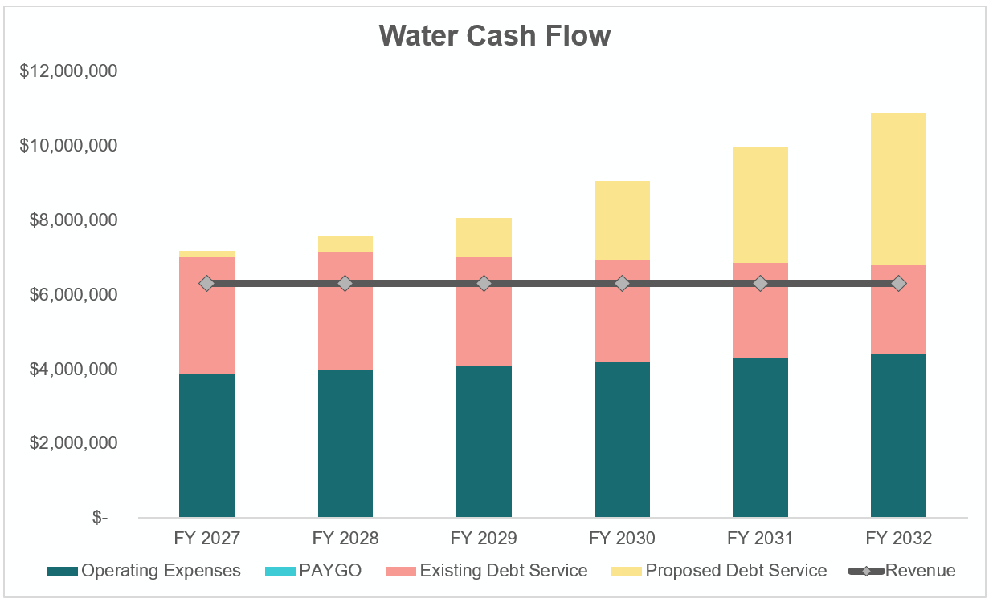
Water Financial Plan with Current Rates
3. Expense growth largely due to new debt service associated with the CIP
2. Minor cost decrease of loan payment as existing loans are repaid
1. Relatively stable projections for operational costs
4. Revenue (at current rates) projected to fall short of expected costs

Slide 12
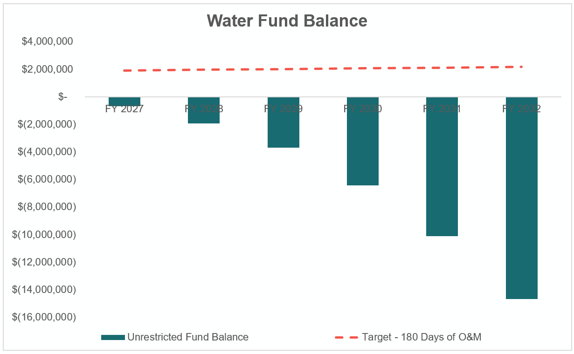
Water Financial Plan with Current Rates
Inflationary impacts will gradually increase the appropriate reserve goals
Projected reserve balances show the fund cannot meet its reserve target without rate adjustments
Without rate adjustments, recurring annual expenses above revenues will need to be subsidized by the General Fund

Slide 13
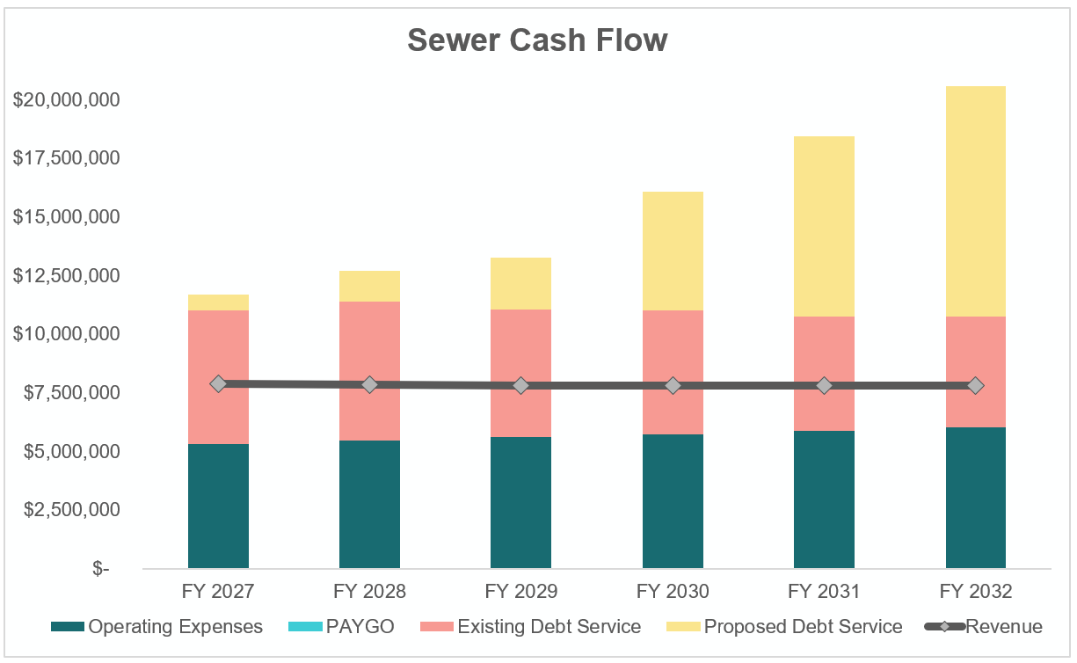
Sewer Financial Plan with Current Rates
3. Expense growth largely due to new debt service associated with the CIP
2. Minor cost decrease as existing loans are repaid
1. Relatively stable projections for operational costs
4. Revenue (at current rates) projected to fall short of expected costs

Slide 14
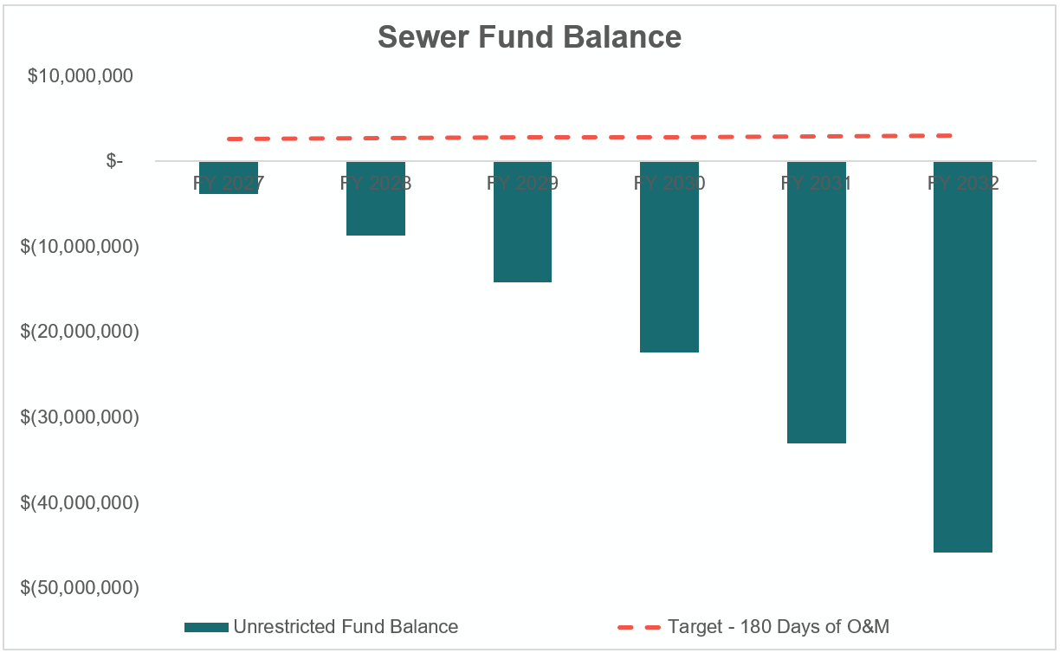
Sewer Financial Plan with Current Rates
Inflationary impacts will gradually increase the appropriate reserve goals
Projected reserve balances show the fund cannot meet its reserve target without rate adjustments
Without rate adjustments, recurring annual expenses above revenues will need to be subsidized by the General Fund

Slide 15
Recommended
Rate Adjustments

Slide 16
Recommended Rate Revenue Increases
Raftelis recommends the following annual increases to the existing revenue base by fiscal year:
Water Fund | FY 2027 | FY 2028 | FY 2029 | FY 2030 | FY 2031 | FY 2032
Rate Revenue Increase (%) | 12.0% | 12.0% | 12.0% | 8.0% | 8.0% | 8.0%
Sewer Fund | FY 2027 | FY 2028 | FY 2029 | FY 2030 | FY 2031 | FY 2032
Rate Revenue Increase (%) | 50.0% | 15.0% | 15.0% | 15.0% | 10.0% | 10.0%

Slide 17
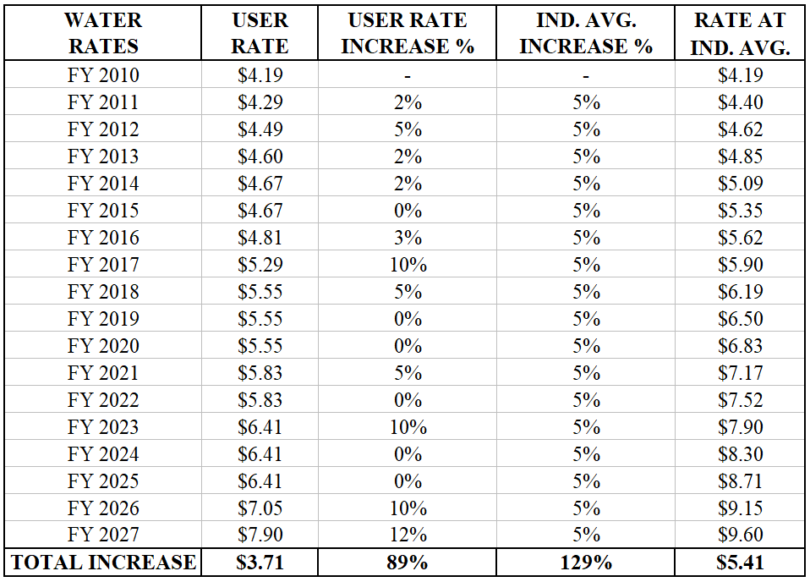
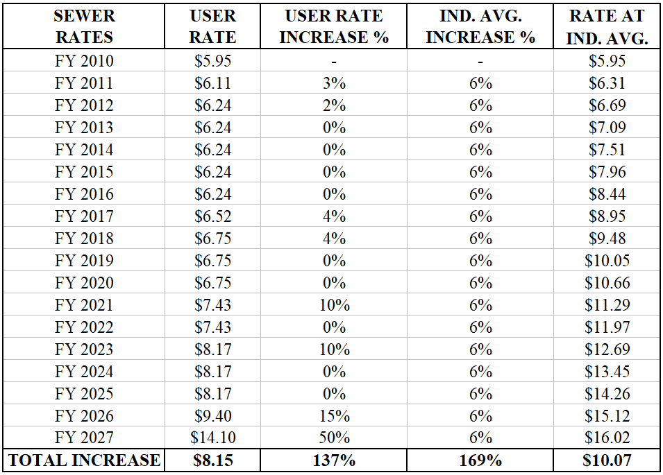
Delayed Increases Are Now Driving Larger Catch-Up Adjustments.

Slide 18
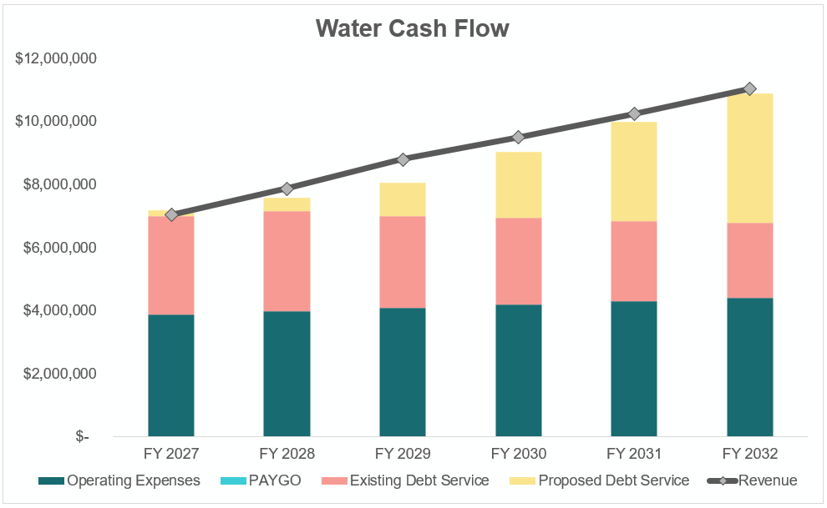
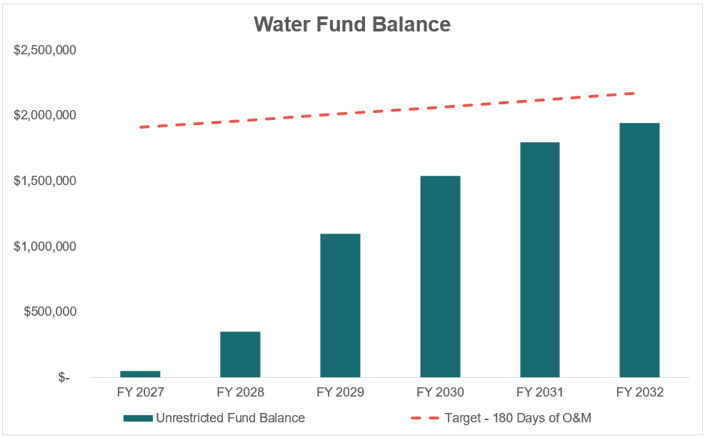
Water Cash Flow with Recommended Rates
With rate adjustments, revenue projected to mirror or modestly outpace expected future costs.
Operational reserve balances begin to grow over time, indicating the enterprise fund will be self-sufficient.

Slide 19
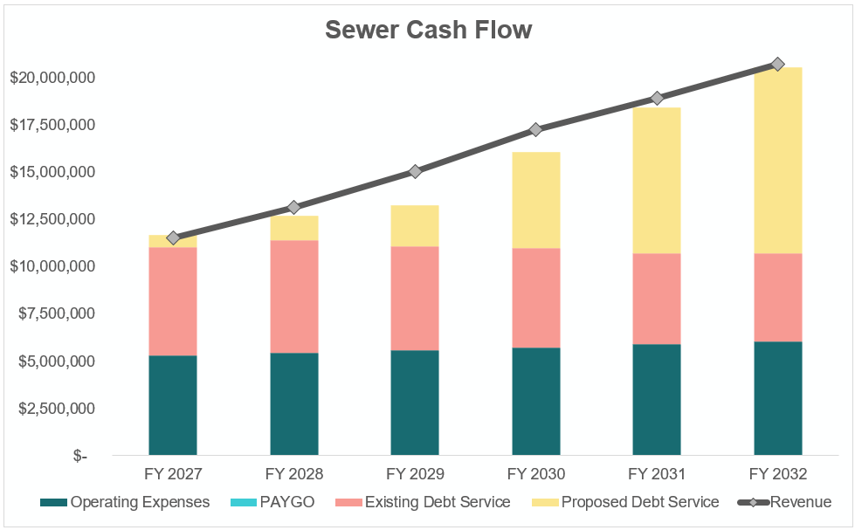
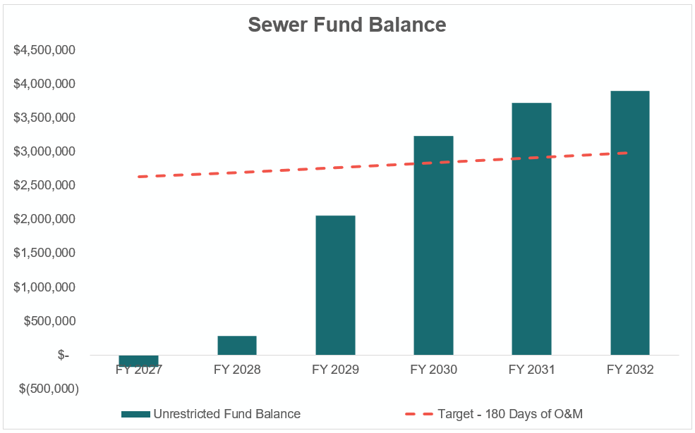
Sewer Cash Flow with Recommended Rates
With rate adjustments, revenue projected to mirror or modestly outpace expected future costs.
Operational reserve balances begin to grow over time, indicating the enterprise fund will be self-sufficient.

Slide 20
Water and Sewer Rate Structure Analysis

Slide 21
Rate Structure Evaluation
Raftelis analyzed two rate structures to compare customer impacts across multiple customer profiles
Option 1:
  Across-the-board rate increase
  No changes to the existing rate structure
Option 2:
  Introduce a 3-tier inclining block rate structure for water and sewer volumetric rates based on customer class (residential, commercial & industrial, and monthly high-volume sewer).
  Minimum charge is replaced with a quarterly fixed charge by meter size in accordance with AWWA meter capacity ratios.
  Senior (exempt) customers retain a uniform water and sewer volumetric rate and have their quarterly fixed charge waived.

Slide 22
Customer Impacts of Recommended
Adjustments

Slide 23
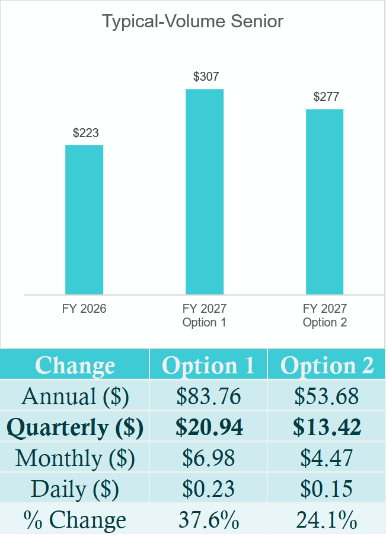
Typical-Volume Senior
Residential Customer
- 6 CCF/Quarter
- 5/8” Meter
Annual Cost Impact of Recommended Adjustments
Option 1: Across-the-board rate increase. No changes to the existing rate structure.
Option 2: Maintain uniform volumetric rate. Seniors pay a uniform volumetric rate set at a 25% discount from the residential Tier 1 rate. The fixed meter charge is waived.

Slide 24
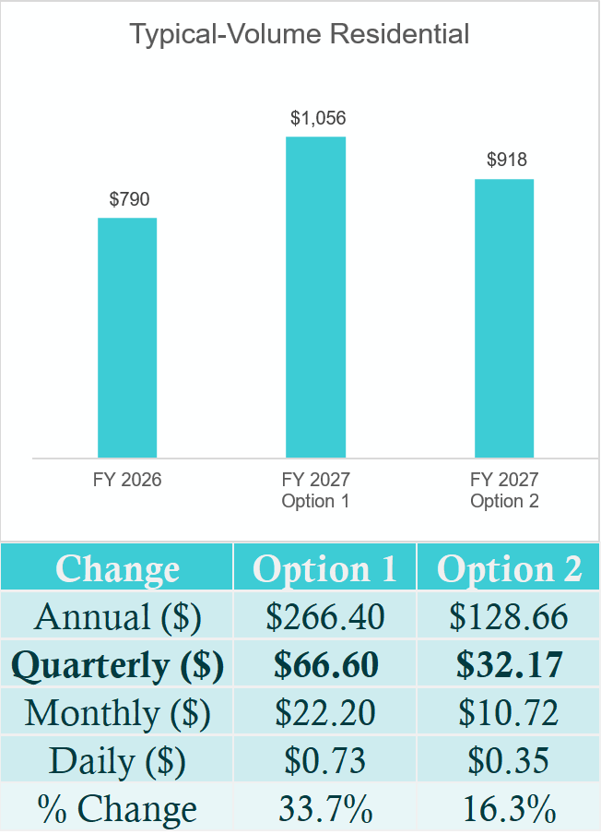
Typical-Volume Single-Family Residential Customer
- 12 CCF/Quarter
- 5/8” Meter
Annual Cost Impact of Recommended Adjustments
Option 1: Across-the-board rate increase. No changes to the existing rate structure.
Option 2: Introduce a 3-tier inclining block rate structure for water and sewer volumetric rates and quarterly fixed charge by meter size
- Tier 1: 0-15 CCF per Quarter
- Tier 2: 16-30 CCF per Quarter
- Tier 3: 31 or more CCF per Quarter

Slide 25
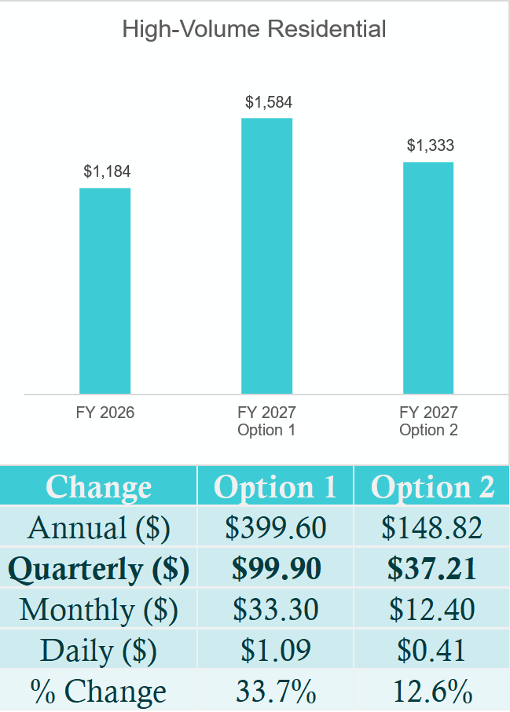
High-Volume Single-Family Residential Customer
- 18 CCF/Quarter
- 5/8” Meter
Annual Cost Impact of Recommended Adjustments
Option 1: Across-the-board rate increase. No changes to the existing rate structure.
Option 2: Introduce a 3-tier inclining block rate structure for water and sewer volumetric rates and quarterly fixed charge by meter size
- Tier 1: 0-15 CCF per Quarter
- Tier 2: 16-30 CCF per Quarter
- Tier 3: 31 or more CCF per Quarter

Slide 26
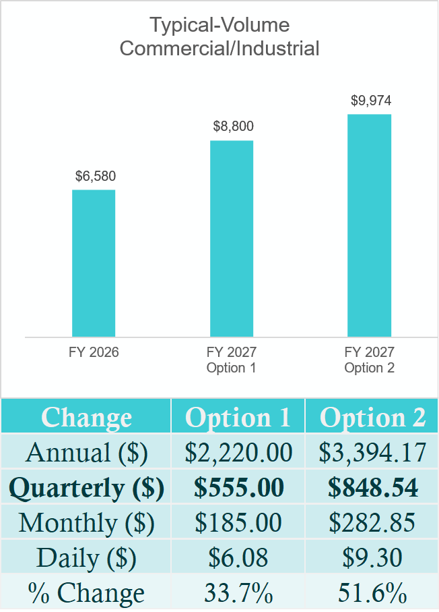
Typical-Volume Commercial or
Industrial
Customer
- 100 CCF/Quarter
- 2” Meter
Annual Cost Impact of Recommended Adjustments
Option 1: Across-the-board rate increase. No changes to the existing rate structure.
Option 2: Introduce a 3-tier inclining block rate structure for water and sewer volumetric rates and quarterly fixed charge by meter size
- Tier 1: 0-15 CCF per Quarter
- Tier 2: 16-30 CCF per Quarter
- Tier 3: 31 or more CCF per Quarter

Slide 27
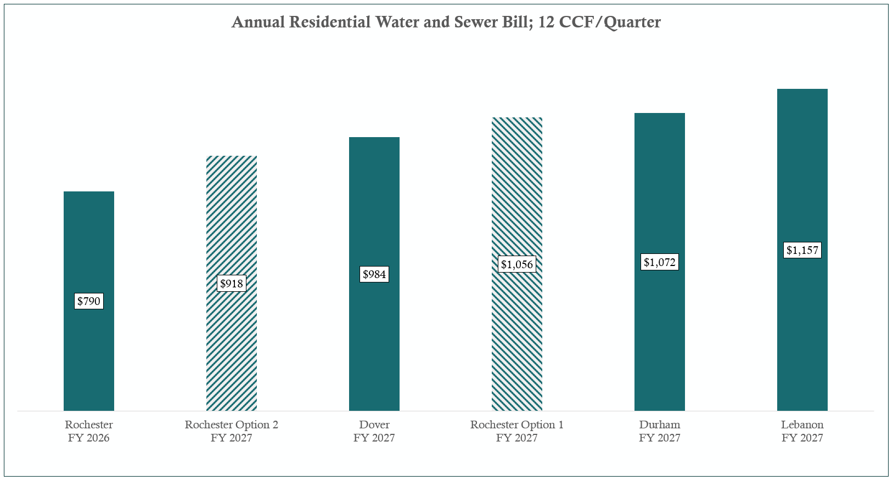
Community Annual Bill Comparison
Annual bills reflect latest published rates by other communities.

Slide 28

QA
&
Thank you!
Dave Fox
Vice President
dfox@raftelis.com

Slide 29
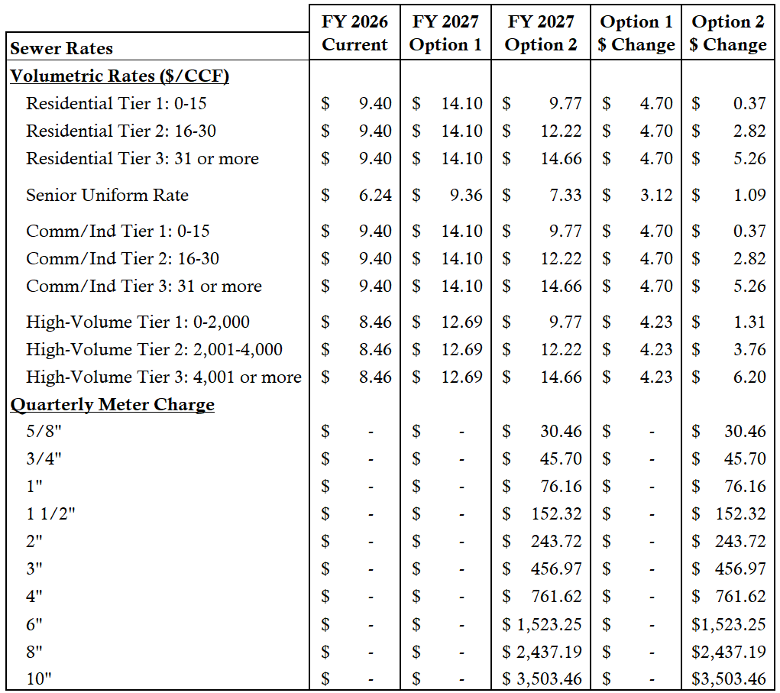
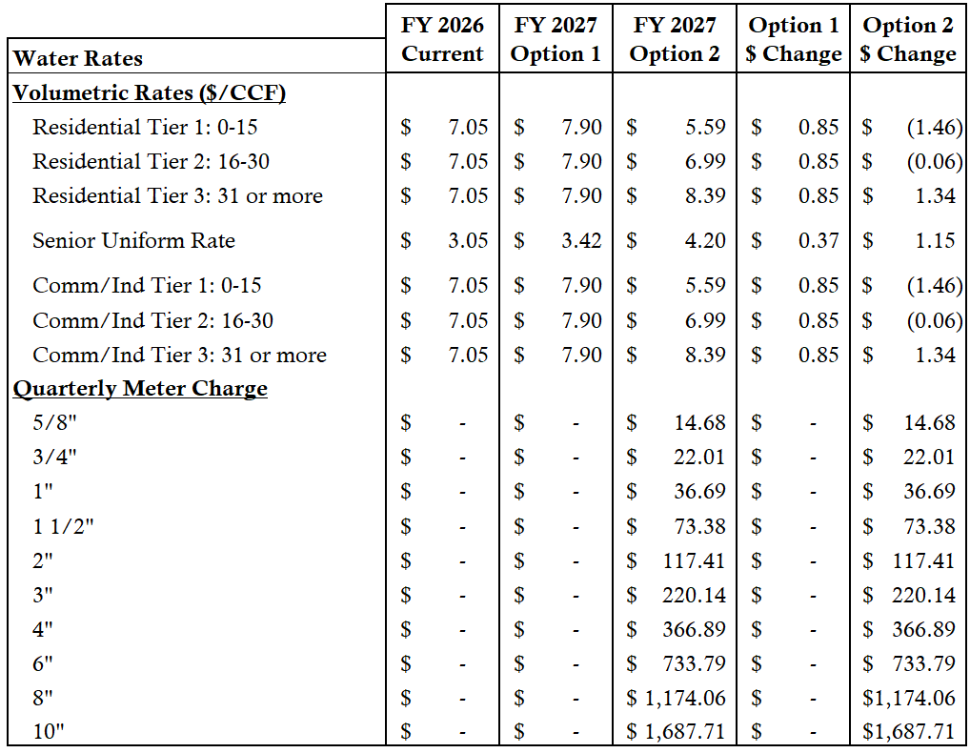
Rates: Current (FY 2026) vs. Proposed (FY 2027)

Slide 30
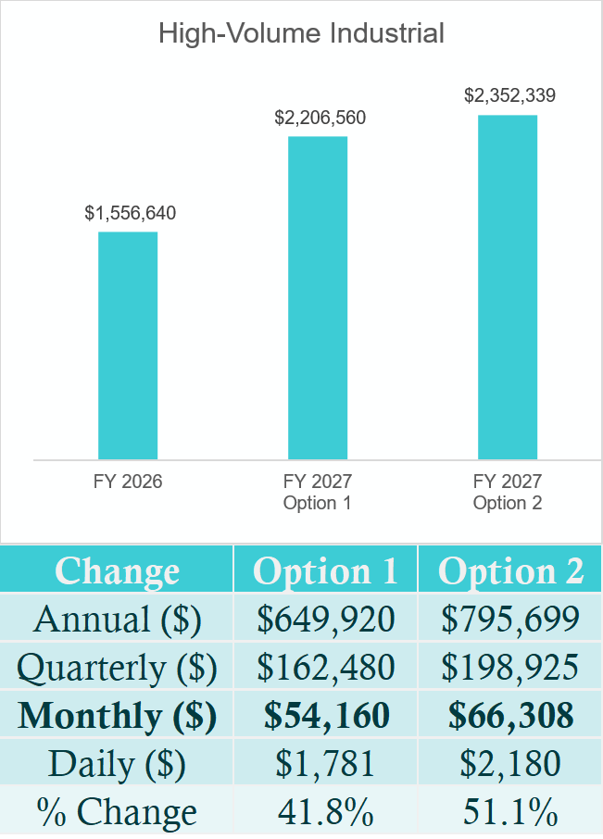
High-Volume
Industrial
Monthly
Customer
- 4,000 CCF/Month Water
- 12,000 CCF/Month Sewer
- 8” Meter
Annual Cost Impact of Recommended Adjustments
Option 1: Across-the-board rate increase. No changes to the existing rate structure.
Option 2: Introduce a 3-tier inclining block rate structure for water and sewer volumetric rates and monthly fixed charge by meter size.
- Tier 1: 0-2,000 CCF per Month
- Tier 2: 2,001-4,000 CCF per Month
- Tier 3: 4,001 or more CCF per Month

